Slide 1

Fall 2011
Chapter 10
Testing and Quality assurance

Slide 2
Objectives
Understand basic techniques for software verification and validation
Analyze basics of software testing and testing techniques
Discuss the basics of inspections

Slide 3
Introduction
Quality Assurance (QA): all activities designed to measure and improve quality in a product --- and process
Quality control (QC): activities designed to verify the quality of the product and detect faults
First, need good process, tools and team

Slide 4
Error detection
Testing: executing program in a controlled environment and verifying output
Inspections and Reviews
Formal methods (proving software correct)
Static analysis detects error-prone conditions

Slide 5
What is quality
Two definitions:
  Conforms to requirements
  Fit to use
Verification: checking the software conforms to its requirements
Validation: checking software meets user requirements (fit to use)

Slide 6
Faults and Failures
Fault (defect, bug): condition that may cause a failure in the system
Failure (problem): inability of system to perform a function according to its spec due to some fault
Error: a mistake made by a programmer or software engineer which caused the fault, which in turn may cause a failure
Explicit and implicit specs
Fault severity (consequences)
Fault priority (importance for developing org)

Slide 7
Testing
Activity performed for
  Evaluating product quality
  Improving products by identifying defects and having them fixed prior to software release.
Dynamic (running-program) verification of program’s behavior on a finite set of test cases selected from execution domain
Testing can’t prove product works - - - even though we use testing to demonstrate that parts of the software works

Slide 8
Testing techniques
Who tests
  Programmers
  Testers
  Users
What is tested
  Unit testing
  Functional testing
  Integration/system testing
  User interface testing
Why test
  Acceptance
  Conformance
  Configuration
  Performance, stress
How (test cases)
  Intuition
  Specification based (black box)
  Code based (white-box)
  Existing cases (regression)
  Faults

Slide 9
Progression of Testing
Unit Test
Functional Test
Unit Test
Component Test
.
.
System/Regression
Test
.
.
.
.
Component Test
Functional Test
Unit Test

Slide 10
Equivalence class partitioning
Black-box technique
Divide the input into several classes, deemed equivalent for purposes of finding errors.
  If fails for one equivalent class, assume it fails for all equivalent classes; if passes for one, passes for all
Representative for each class used for testing.
Equivalence classes determined by intuition and specs
Example: largest
Class | Representative
First > Second | 10,7
Second > First | 8,12
First = second | 6,6
Example: age groups
Class | Representative
Low | -5
0-12 | 6
13-19 | 15
20-35 | 30
36-120 | 60
High | 160

Slide 11
Boundary value analysis
Boundaries are error-prone
Do equivalence-class partitioning, add test cases for boundaries (boundary, +1, -1)
Reduced cases: consider boundary as falling between numbers
  boundary is 12, normal: 11,12,13; reduced: 12,13 (boundary between 12 and 13)
Large number of cases (~3 per class)
Only for ordinal values (or no boundaries)

Slide 12
Boundary Values and Reduced Test Cases
Example: age groups
Class | All Cases | Belonging Cases | Reduced Cases
Low | -1,0 | -1 | -1
0-12 | -1,0,1 11,12,13 | 0,1 11,12 | 0 12
13-19 | 12,13,14 18,19,20 | 13,14 18,19 | 19
20-35 | 19,20,21 34,35,36 | 20,21 34,35 | 35
36-120 | 34,35,36 119,120,121 | 35,36 119,120 | 120
High | 120,121 | 121 | 121

Slide 13
Path Analysis
S1
1
C1
2
White-Box technique
Two tasks
  Analyze number of paths in program
  Decide which ones to test
Decreasing coverage
  Logical paths
  Independent paths
  Branch coverage
  Statement coverage
4
S2
3
S3
Single Logical Structure
Path1 : S1 – C1 – S3
Path2 : S1 – C1 – S2 – S3
OR
Path1: segments (1,4)
Path2: segments (1,2,3)
Both paths must be traversed to cover all statements

Slide 14
Statement Coverage
S1
The 4 Independent Paths Covers:
Path1: includes S1-C1-S2-S5
Path2: includes S1-C1-C2-S3-S5
Path3: includes S1-C1-C2-C3-S4-S5
Path4: includes S1-C1-C2-C3-S5
1
C1
2
S2
8
5
C2
3
S3
9
6
Only need to traverse Path1, Path2, and Path3 to cover all statements
C1, C2, C3, S1, S2, S3, S4, S5
Need to traverse all four paths to cover all branches
C1—S2, C1—C2, C2—S3, C2—C3, C3—S4, C3—S5
C3
4
S4
10
7
S5
A CASE Structure

Slide 15
Example with a Loop
Branch Coverage
S1
Linearly Independent Paths are:
path1 : S1-C1-S3 (segments 1,4)
path2 : S1-C1-S2-C1-S3 (segments 1,2,3,4)
1
C1
4
S3
Only need to traverse Path2, to cover all statements
S1, C1, S2, S3
Path2 also covers all branches
C1—S2, C1—S3
2
S2
3
Linearly Independent Set: every path may be constructed as a “linear combination” of paths from this set
A Simple Loop Structure

Slide 16
Linearly Independent Set of Paths
Linearly Independent Set
1
2
3
4
5
6
path1
1
1
1
C1
path2
1
1
2
1
S1
path3
1
1
1
3
path4
1
1
1
1
C2
5
4
S1
Consider path1, path2 and path3 as the Linearly Independent Set
6

Slide 17
Total # of Paths and Linearly Independent Paths
Since for each binary decision, there are 2 paths and
there are 3 in sequence, there are 2³ = 8 total “logical” paths
path1 : S1-C1-S2-C2-C3-S4
path2 : S1-C1-S2-C2-C3-S5
path3 : S1-C1-S2-C2-S3-C3-S4
path4 : S1-C1-S2-C2-S3-C3-S5
path5 : S1-C1-C2-C3-S4
path6 : S1-C1-C2-C3-S5
path7 : S1-C1-C2-S3-C3-S4
path8 : S1-C1-C2-S3-C3-S5
S1
1
C1
2
3
S2
4
C2
5
S3
6
7
How many Linearly Independent paths are there?
Using Cyclomatic number = 3 decisions +1 = 4
One set would be:
path1 : includes segments (1,2,4,6,9)
path2 : includes segments (1,2,4,6,8)
path3 : includes segments (1,2,4,5,7,9)
path5 : includes segments (1,3,6,9)
C3
8
9
S5
S4

Slide 18
Combinations of Conditions
Function of several variables
To fully test, we need all possible combinations (of equivalence classes)
How to reduce
  Coverage analysis
  Assess important cases
  Test all pairs (but not all combinations)

Slide 19
Unit Testing
Unit Testing: Test each individual unit
Usually done by the programmer
Test each unit as it is developed (small chunks)
Keep tests around (use Junit or xxxUnit)
  Allows for regression testing
  Facilitates refactoring
  Tests become documentation !!

Slide 20
Test-Driven development
Write unit-tests BEFORE the code !
Tests are requirements
Forces development in small steps
Steps
  Write test case
  Verify it fails
  Modify code so it succeeds
  Rerun test case, previous tests
  Refactor

Slide 21
When to stop testing ?
Simple answer, stop when
  All planned test cases are executed
  All problems found are fixed
Other techniques
  Stop when you are not finding any more errors
  Defect seeding

Slide 22
Problem Find Rate
Problem
Find Rate
# of Problems
Found per hour
Time
Day
1
Day
2
Day
3
Day
4
Day
5
Decreasing Problem Find Rate

Slide 23
Inspections and Reviews
Review: any process involving human testers reading and understanding a document and then analyzing it with the purpose of detecting errors
Walkthrough: author explaining document to team of people
Software inspection: detailed reviews of work in progress, following Fagan’s method.

Slide 24
Software Inspections
Steps:
  Planning
  Overview
  Preparation
  Examination
  Rework
  Follow-Up
Focused on finding defects
Output: list of defects
Teams:
  3-6 people
  Author included
  Working on related efforts
  Moderator, reader, scribe

Slide 25
Inspections vs Testing
Inspections
  Cost-effective
  Can be applied to intermediate artifacts
  Catches defects early
  Helps disseminate knowledge about project and best practices
Testing
  Finds errors cheaper, but correcting them is expensive
  Can only be applied to code
  Catches defects late (after implementation)
  Necessary to gauge quality

Slide 26
Formal Methods
Mathematical techniques used to prove that a program works
Used for requirements specification
Prove that implementation conforms to spec
Pre and Post conditions
Problems:
  Require math training
  Not applicable to all programs
  Only verification, not validation
  Not applicable to all aspects of program (say UI)

Slide 27
Static Analysis
Examination of static structures of files for detecting error-prone conditions
Automatic programs are more useful
Can be applied to:
  Intermediate documents (but in formal model)
  Source code
  Executable files
Output needs to be checked by programmer

Slide 28
Testing Process
Testing

Slide 29
Testing
Testing only reveals the presence of defects
Does not identify nature and location of defects
Identifying & removing the defect => role of debugging and rework
Preparing test cases, performing testing, defects identification & removal all consume effort
Overall testing becomes very expensive : 30-50% development cost
Testing

Slide 30
Incremental Testing
Goals of testing: detect as many defects as possible, and keep the cost low
Both frequently conflict - increasing testing can catch more defects, but cost also goes up
Incremental testing - add untested parts incrementally to tested portion
For achieving goals, incremental testing essential
  helps catch more defects
  helps in identification and removal
Testing of large systems is always incremental
Testing

Slide 31
Integration and Testing
Incremental testing requires incremental ‘building’ I.e. incrementally integrate parts to form system
Integration & testing are related
During coding, different modules are coded separately
Integration - the order in which they should be tested and combined
Integration is driven mostly by testing needs
Testing

Slide 32
Top-down and Bottom-up
System : Hierarchy of modules
Modules coded separately
Integration can start from bottom or top
Bottom-up requires test drivers
Top-down requires stubs
Both may be used, e.g. for user interfaces top-down; for services bottom-up
Drivers and stubs are code pieces written only for testing
Testing

Slide 33
Levels of Testing
The code contains requirement defects, design defects, and coding defects
Nature of defects is different for different injection stages
One type of testing will be unable to detect the different types of defects
Different levels of testing are used to uncover these defects
Testing

Slide 34
Levels of Testing…
User needs
Acceptance testing
Requirement
specification
System testing
Design
Integration testing
code
Unit testing
Testing

Slide 35
Unit Testing
Different modules tested separately
Focus: defects injected during coding
Essentially a code verification technique, covered in previous chapter
Unit Testing is closely associated with coding
Frequently the programmer does Unit Testing; coding phase sometimes called “coding and unit testing”
Testing

Slide 36
Integration Testing
Focuses on interaction of modules in a subsystem
Unit tested modules combined to form subsystems
Test cases to “exercise” the interaction of modules in different ways
May be skipped if the system is not too large
Testing

Slide 37
System Testing
Entire software system is tested
Focus: does the software implement the requirements?
Validation exercise for the system with respect to the requirements
Generally the final testing stage before the software is delivered
May be done by independent people
Defects removed by developers
Most time consuming test phase
Testing

Slide 38
Acceptance Testing
Focus: Does the software satisfy user needs?
Generally done by end users/customer in customer environment, with real data
The software is deployed only after successful Acceptance Testing
Any defects found are removed by developers
Acceptance test plan is based on the acceptance test criteria in the SRS
Testing

Slide 39
Other forms of testing
Performance testing
  Tools needed to “measure” performance
Stress testing
  load the system to peak, load generation tools needed
Regression testing
  Test that previous functionality works alright
  Important when changes are made
  Previous test records are needed for comparisons
  Prioritization of test cases needed when complete test suite cannot be executed for a change
Testing

Slide 40
Test Plan
Testing usually starts with test plan and ends with acceptance testing
Test plan is a general document that defines the scope and approach for testing for the whole project
Inputs are SRS, project plan, design
Test plan identifies what levels of testing will be done, what units will be tested, etc in the project
Testing

Slide 41
Test Plan…
Test plan usually contains
  Test unit specifications: what units need to be tested separately
  Features to be tested: these may include functionality, performance, usability,…
  Approach: criteria to be used, when to stop, how to evaluate, etc
  Test deliverables
  Schedule and task allocation
  Example Test Plan
    IEEE Test Plan Template
Testing

Slide 42
Test case specifications
Test plan focuses on approach; does not deal with details of testing a unit
Test case specification has to be done separately for each unit
Based on the plan (approach, features,..) test cases are determined for a unit
Expected outcome also needs to be specified for each test case
Testing

Slide 43
Test case specifications…
Together the set of test cases should detect most of the defects
Would like the set of test cases to detect any defect, if it exists
Would also like set of test cases to be small - each test case consumes effort
Determining a reasonable set of test cases is the most challenging task of testing
Testing

Slide 44
Test case specifications…
The effectiveness and cost of testing depends on the set of test cases
Q: How to determine if a set of test cases is good? I.e. the set will detect most of the defects, and a smaller set cannot catch these defects
No easy way to determine goodness; usually the set of test cases is reviewed by experts
This requires test cases be specified before testing – a key reason for having test case specifications
Test case specifications are essentially a table
Testing

Slide 45
Test case specifications…
Seq.No
Condition
to be tested
Expected
result
successful
Test Data
Testing

Slide 46
Test case specifications…
So for each testing, test case specifications are developed, reviewed, and executed
Preparing test case specifications is challenging and time consuming
  Test case criteria can be used
  Special cases and scenarios may be used
Once specified, the execution and checking of outputs may be automated through scripts
  Desired if repeated testing is needed
  Regularly done in large projects
Testing

Slide 47
Test case execution and analysis
Executing test cases may require drivers or stubs to be written; some tests can be automatic, others manual
  A separate test procedure document may be prepared
Test summary report is often an output – gives a summary of test cases executed, effort, defects found, etc
Monitoring of testing effort is important to ensure that sufficient time is spent
Computer time also is an indicator of how testing is proceeding
Testing

Slide 48
Defect logging and tracking
A large software system may have thousands of defects, found by many different people
Often person who fix the defect (usually the coder) is different from the person who finds the defect
Due to large scope, reporting and fixing of defects cannot be done informally
Defects found are usually logged in a defect tracking system and then tracked to closure
Defect logging and tracking is one of the best practices in industry
Testing

Slide 49
Defect logging…
A defect in a software project has a life cycle of its own, like
  Found by someone, sometime and logged along with information about it (submitted)
  Job of fixing is assigned; person debugs and then fixes (fixed)
  The manager or the submitter verifies that the defect is indeed fixed (closed)
More elaborate life cycles possible
Testing

Slide 50
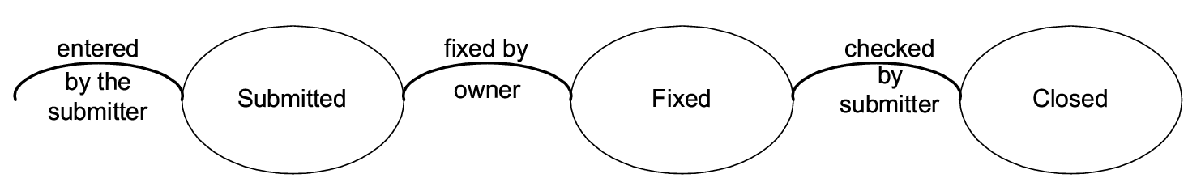
Defect logging…
Testing

Slide 51
Defect logging…
During the life cycle, information about defect is logged at different stages to help debug as well as analysis
Defects generally categorized into a few types, and type of defects is recorded
  Orthogonal Defect Classification (ODC) is one classification with categories
    Functional, interface, assignment, timing, documentation, algorithm
  Some standard industry categories
    Logic, standards, user interface, component interface, performance, documentation
Testing

Slide 52
Defect logging…
Severity of defects in terms of its impact on software is also recorded
Severity useful for prioritization of fixing
One categorization
  Critical: Show stopper
  Major: Has a large impact
  Minor: An isolated defect
  Cosmetic: No impact on functionality
See sample peer review form
  Peer Review Form
Testing

Slide 53
Defect logging and tracking…
Ideally, all defects should be closed
Sometimes, organizations release software with known defects (hopefully of lower severity only)
Organizations have standards for when a product may be released
Defect log may be used to track the trend of how defect arrival and fixing is happening
Testing

Slide 54
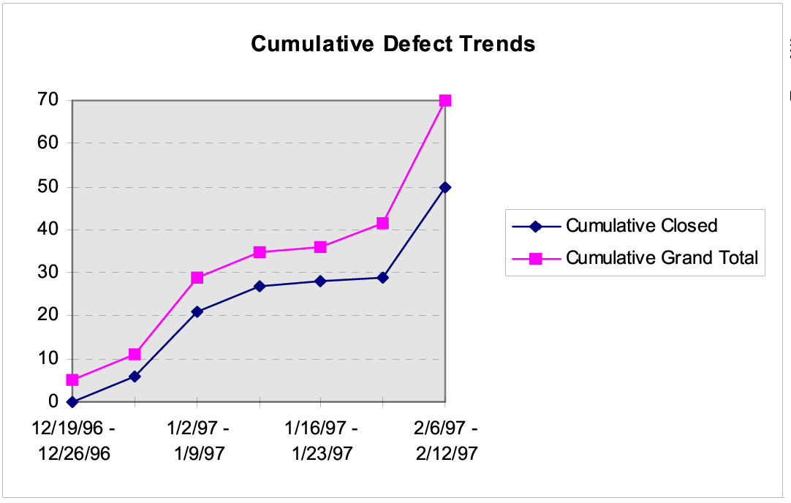
Defect arrival and closure trend
Testing

Slide 55
Defect analysis for prevention
Quality control focuses on removing defects
Goal of defect prevention is to reduce the defect injection rate in future
Defect Prevention done by analyzing defect log, identifying causes and then remove them
Is an advanced practice, done only in mature organizations
Finally results in actions to be undertaken by individuals to reduce defects in future
Testing

Slide 56
Metrics - Defect removal efficiency
Basic objective of testing is to identify defects present in the programs
Testing is good only if it succeeds in this goal
Defect removal efficiency of a Quality Control activity = % of present defects detected by that Quality Control activity
High Defect Removal Efficiency of a quality control activity means most defects present at the time will be removed
Testing
Notes:
22

Slide 57
Defect removal efficiency …
Defect Removal Efficiency for a project can be evaluated only when all defects are know, including delivered defects
Delivered defects are approximated as the number of defects found in some duration after delivery
The injection stage of a defect is the stage in which it was introduced in the software, and detection stage is when it was detected
  These stages are typically logged for defects
With injection and detection stages of all defects, Defect Removal Efficiency for a Quality Control activity can be computed
Testing
Notes:
25

Slide 58
Defect Removal Efficiency …
Defect Removal Efficiencies of different Quality Control activities are a process property - determined from past data
Past Defect Removal Efficiency can be used as expected value for this project
Process followed by the project must be improved for better Defect Removal Efficiency
Testing
Notes:
26

Slide 59
Metrics – Reliability Estimation
High reliability is an important goal being achieved by testing
Reliability is usually quantified as a probability or a failure rate
For a system it can be measured by counting failures over a period of time
Measurement often not possible for software as due to fixes reliability changes, and with one-off, not possible to measure
Testing

Slide 60
Reliability Estimation…
Software reliability estimation models are used to model the failure followed by fix model of software
Data about failures and their times during the last stages of testing is used by these model
These models then use this data and some statistical techniques to predict the reliability of the software
A simple reliability model is given in the book
Testing

Slide 61
Summary
Testing plays a critical role in removing defects, and in generating confidence
Testing should be such that it catches most defects present, i.e. a high Defect Removal Efficiency
Multiple levels of testing needed for this
Incremental testing also helps
At each testing, test cases should be specified, reviewed, and then executed
Testing

Slide 62
Summary …
Deciding test cases during planning is the most important aspect of testing
Two approaches – black box and white box
Black box testing - test cases derived from specifications.
  Equivalence class partitioning, boundary value, cause effect graphing, error guessing
White box - aim is to cover code structures
  statement coverage, branch coverage
Testing

Slide 63
Summary…
In a project both used at lower levels
  Test cases initially driven by functionality
  Coverage measured, test cases enhanced using coverage data
At higher levels, mostly functional testing done; coverage monitored to evaluate the quality of testing
Defect data is logged, and defects are tracked to closure
The defect data can be used to estimate reliability, Defect Removal Efficiency
Testing

